Slide 1
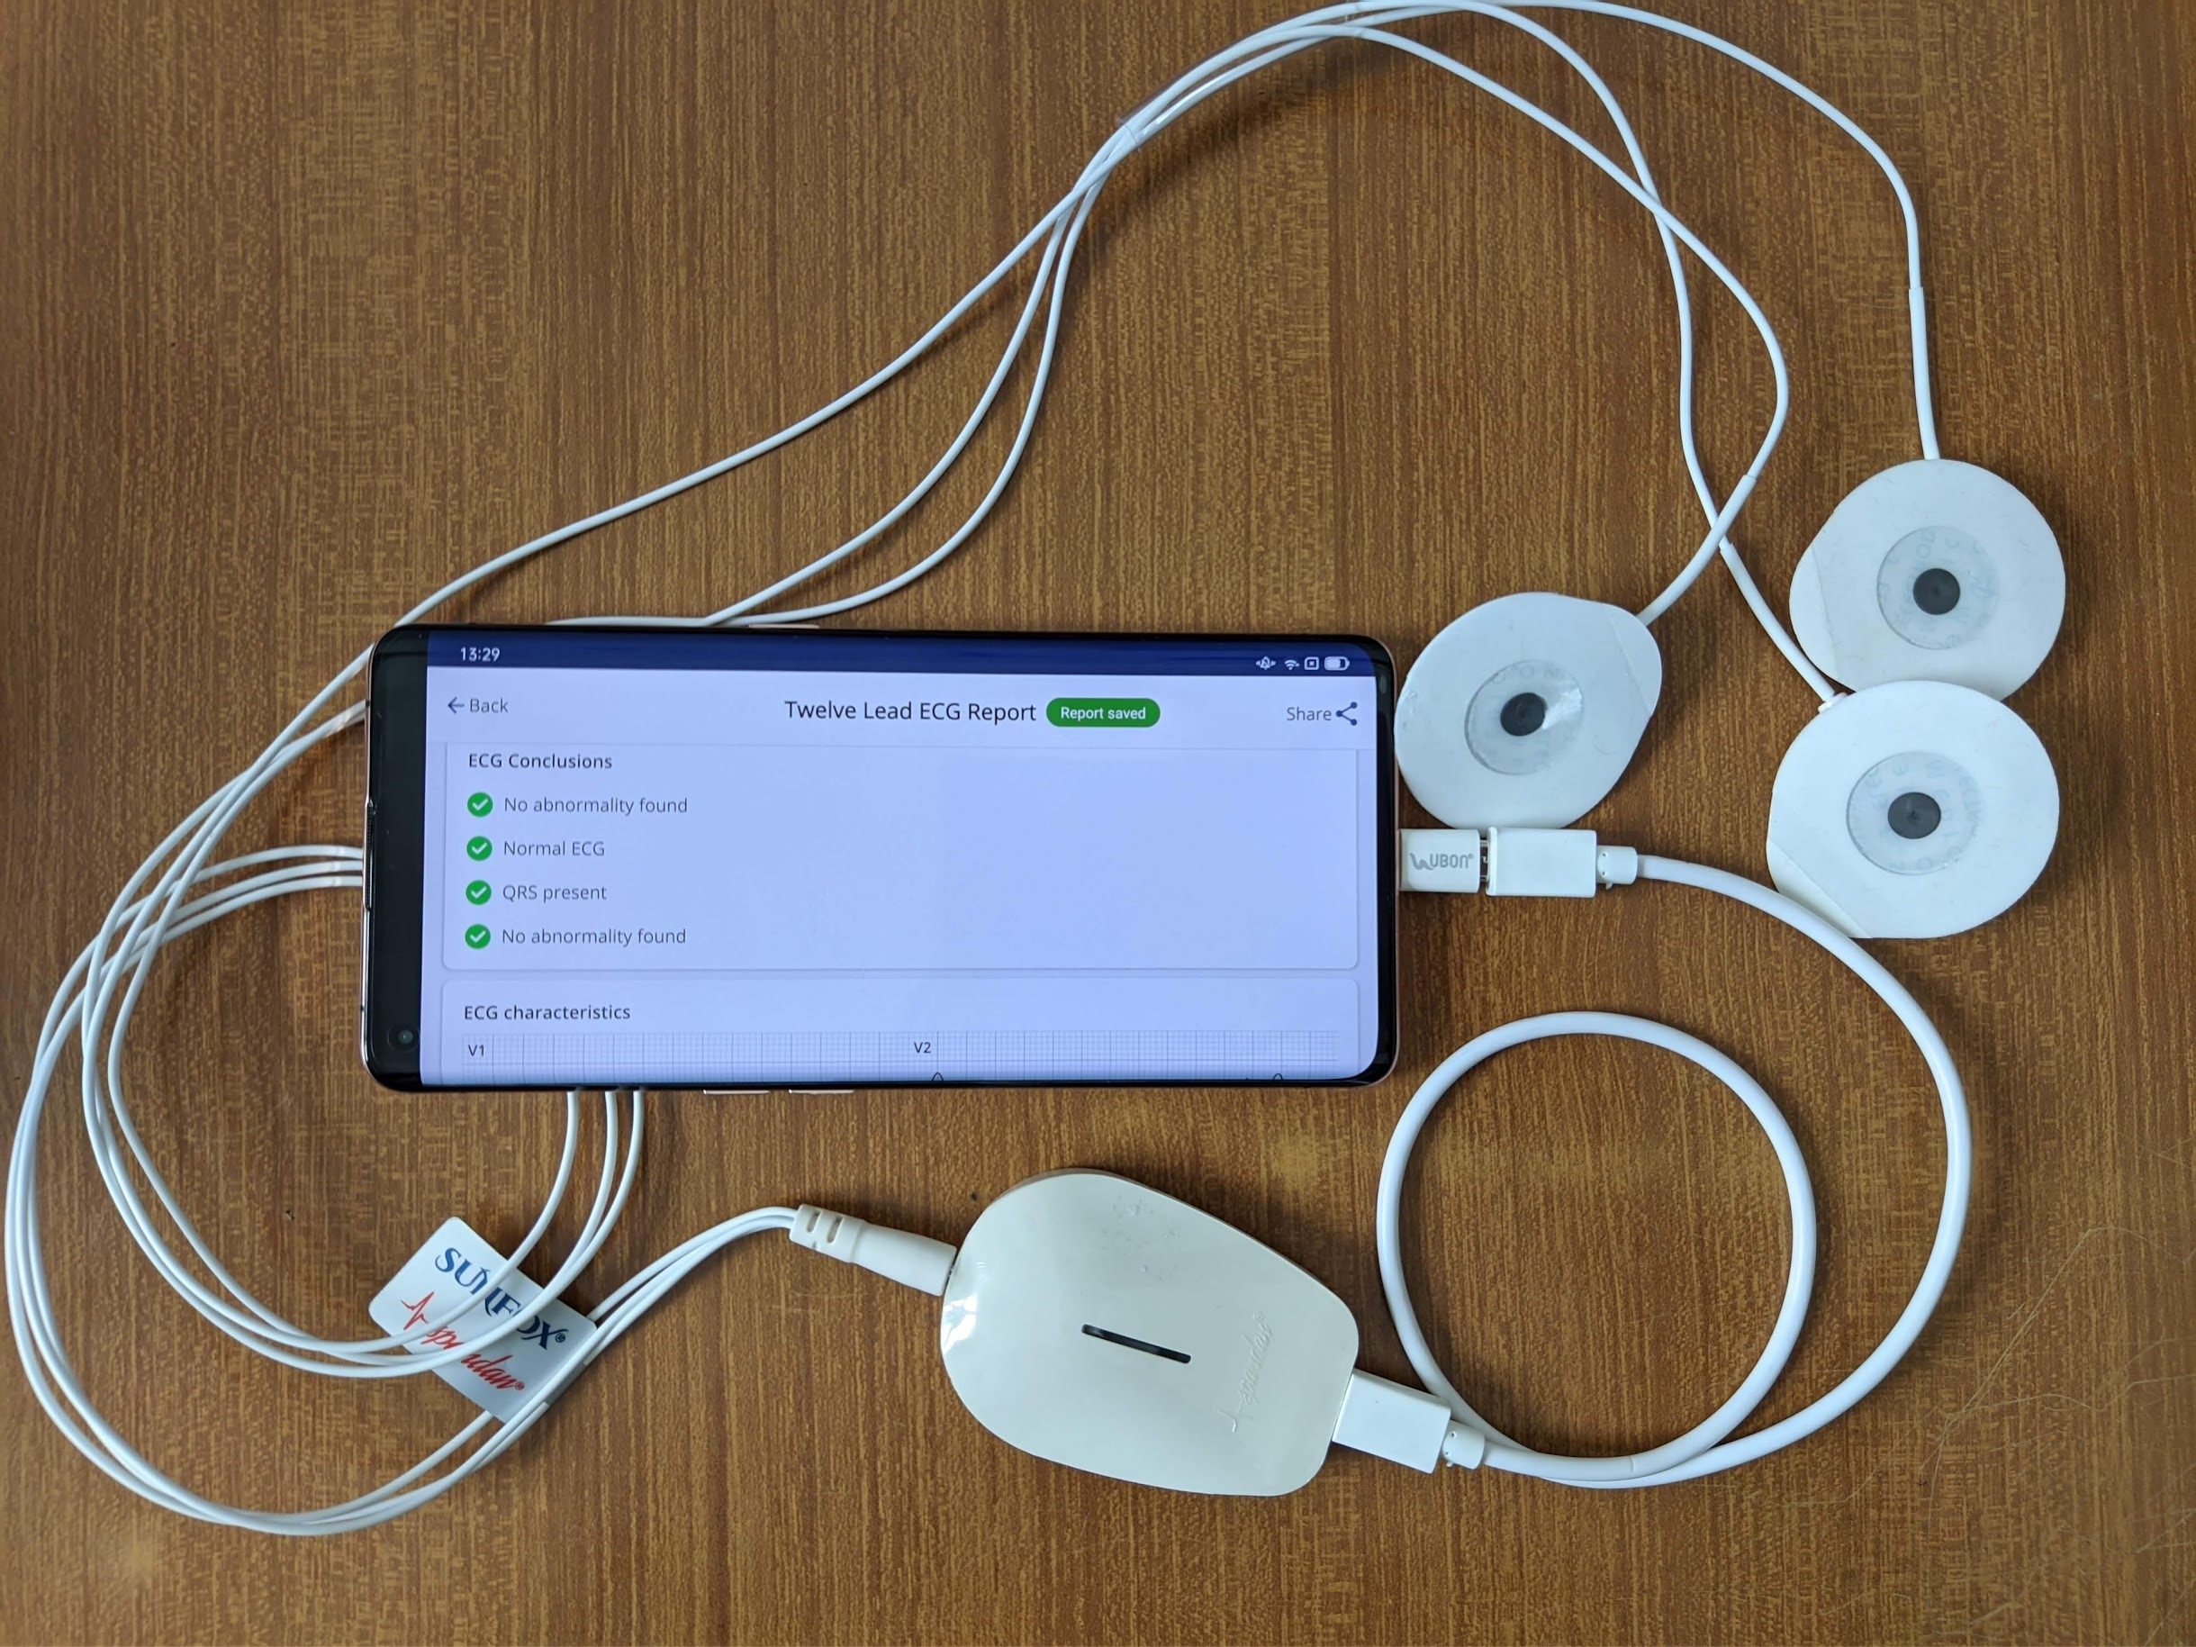
Introducing the Pocket-Sized ECG Device
Revolutionizing Heart Health Monitoring
Presented by: Sameer Ahmed, Abdur Rehman, Sosna Kassa , Piera

Slide 2

Cardiac Health Challenges in Italy
35-40% of deaths in Italy are due to cardiovascular diseases
Sudden Cardiac Death (SCD): Approx. 50-100 per 100,000 individuals annually
Undiagnosed Conditions: Many deaths are preventable with early detection

Slide 3

Solution & Methodology
Portable ECG Device & Development Plan
Portable & Convenient: Fits in your pocket, connects to smartphones
Methodology:
  Research & Design: Comprehensive study and initial prototype design
  Software Development: MATLAB coding and mobile app integration
  Prototype Manufacturing: Initial prototypes for testing
  Testing & Validation: Lab and user testing for accuracy

Slide 4

Budget Allocation (50,000 EUR)
Category | Amount (EUR)
Research & Design
Software Development | 15,000
Prototype Manufacturing | 15,000
Testing & Validation | 5,000
Miscellaneous Expenses | 5,000
Total | 50,000

Slide 5

Timeline & Benefits
Timeline:
  Research & Design: End of June 2024
  Software Development: End of August 2024
  Prototype Manufacturing: End of October 2024
  Testing & Validation: End of November 2024
  Preliminary Final Version: End of December 2024
Benefits:
  Early Detection
  Timely Intervention
  Empowerment
  Accessibility

Slide 6


